Slide 1
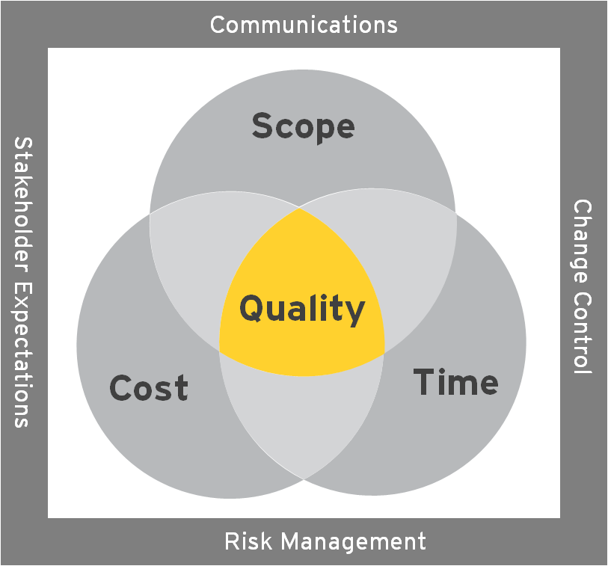
7. RAID trends and observations
 |  | Top Critical Risks and Issues
Item | Background | Description | Impact | Action
R26 R67 A&DM | To re-platform large volumes of Lotus Notes applications into a new technology, the A&DM Program will deliver in a factory approach driving consistency across the firm. The A&DM Operating Model states how the factory will work with the existing IT Service Delivery teams and the business. Agreement has been reached on the A&M Operating Model on most items other than who manages the requirements and design phases – the A&DM Program or IT Service Delivery teams. | The benefits of a factory delivery approach cannot be leveraged if the IT Service Delivery teams manage the requirement and design phases. The Phase 1 project team are encountering resistance from some IT Service Delivery teams when performing the business requirements activities. | Until a decision is reached and communicated the A&DM project team will continue to meet resistance as they progress through delivery which results in delays to the plan and a challenging working relationship. | Escalate to Mo for a decision. Communicate decision to all CBS, Markets and Cross-Org Leaders.
R102 A&DM | The Rediscovery team published the first of four reports (containing around 18k applications) to some of the IT Service Delivery teams on Monday 30th Jan’12 for review/validation. | Some of the IT Service Delivery teams have flagged that they do not have the time or budget (charge code from A&DM) to review/validate the report – their input is required to agree the future state for each application. | The A&DM team will not have the required agreement to re-platform, decommission, archive, etc. applications. As a consequence, EY will not be able to realize the rebates from MS for decommissioning Lotus Notes applications. | Agree priority at the CLT ref supporting the A&DM Rediscovery team vs. other in-flight projects. Agree direction at the CLT red where IT Service Delivery teams should book time spend supporting the A&DM Program. Communicate agreed decisions to all CBS, Markets and Cross-Org Leaders.

Slide 2
2. Overall assessment of Program health
PMO Narrative
Budget
Schedule – Overall status RED
Resource.
RAIDs. RAG status reflects the workstream’s progress with regards to the completion of cleaning up of their RAIDs. Our clean-up of risks and issues continues. Summaries of missing data (by workstream) are being distributed twice a week, with detailed information going out on Mondays. SharePoint and Tech Foundation have the most decisions to revalidate in light of the cloud decision. SharePoint reviewed their items this week, and Tech Foundation’s review is in progress. 7 new risks were raised this week.
Commercial/Vendor.
General .
Weekly Ratings
 | Program Assessment (Per PM Tool) |  |  |  | PMO Assessment
Program | Overall | Scope | Time | Cost | RAID | Resource | Financial | Schedule | Vendor
SharePoint |  |  |  |  | Red
App & Data |  |  |  |  | Green
Change Management |  |  |  |  | Green
Unified Communications |  |  |  |  | Amber
Tech Foundation |  |  |  |  | Red
IT Transition Management |  |  |  |  | ???
Business Deployment
Release Management
Overall |  |  |  |  | Red
 |  | RAG Trend
Program | This week | Last week | Week -2 | Week -3 | Week -4 | Week -5 | Week -6
SharePoint
App & Data
Infrastructure
Change Management
Tech Foundation
Unified Communications
IT Transition Management
Business Deployment
Release Management
Notes:
Cost
GREEN - Estimate at Completion (EAC) = + 0 - 5% of approved spend (cost baseline + approved change requests)
AMBER - Estimate at Completion (EAC) = + 6 - 10% of approved spend (cost baseline + approved changes) and/or pending spend
RED – Estimate at Completion (EAC) exceeds + 10% or $100,000 of approved spend (cost baseline + approved changes) and/or pending spend or no project budget defined
Schedule
GREEN - The project schedule supports the end date of the project (with some elapsed time contingency).
AMBER - The project schedule supports the end date, but issues, risks and/or changes exist that may put the date in jeopardy.
RED – The project schedule does not exist and/or the project schedule does not support the end of the project.
Scope
GREEN - Scope defined and approved (scope baseline) with no pending change requests.
AMBER - Scope defined and approved (scope baseline) with pending change requests – known and not raised and raised but not agreed.
RED – Scope undefined or unapproved (no scope baseline) and/or multiple pending change requests.
Risk
GREEN – Low amount of risks with negligible impact
AMBER – Medium amount of risks. High or medium impact but with mitigation actions in place. Time left to put in place mitigation plans.
RED – High number of risks. High score risks which impact in the near term. No mitigation in place for High risks.
Issue
GREEN – No or low impact issues. Medium impact issues with resolution plans agreed and in place.
AMBER – Large amount of issues and/or Medium impact issues with no resolution plans.
RED – High impact issues present. No resolution plans in place for Medium of High level issues
Commercial
GREEN - TBD
AMBER - TBD
RED – TBD
Resource
GREEN – No resource issue or constraints
AMBER – Resource issues exist but plans are in place to resolve.
RED – Resource issues exist with no plans in place to resolve.

